Slide 1
X-FILES
PITCH DECK

Slide 2

YOUR INTEGRITY PARTNER

Slide 3
I – Reporters mission is to fight corruption by strengthening integrity. Corruption is a major menace from government institutions to large companies and even small businesses. The consequences are dire from public distrust, embezzlement of funds, increase in violence and even in extreme cases death. I-Reporter exists to change the narrative by upholding integrity into the broken systems.
MISSION

Slide 4
OPPORTUNITY
Corruption cases are rampant in Africa and the world beyond. Top government officials and other prominent leaders who take part in acts of corruption seldom get reprimanded for their actions.
This is attributed to their power to influence evidence presented against them.
Whistle blowers may come forth to report acts of corruption. However, their efforts can be thwarted if the accused parties get their hands into evidence presented against them. Once they succeed in modification of the evidence, courts and other judicial systems have no option but to acquit them. The laws of the land dictate that one can only face legal action if sufficient evidence is presented against them in court.
This hence creates a need to ensure evidence is not tampered with and integrity is retained. This ensures sufficient evidence is presented in the courts and the guilty persons face the necessary legal action.

Slide 5

TARGET CUSTOMERS
Whistle blowers
Anti-corruption commission offices
Courts
Journalists
Netizens
Citizens

Slide 6
SOLUTION
I-reporter is a web -based application that allows whistle-blowers to report incidents of corruption.
The whistle blower can feed in specific details such as location, nature of corruption, date, duration and so on.
They can also upload an evidence file in form of images, video or audio. The evidence presented is used in the smart contract that runs on the distributed ledger.
It is given a private key and each node in the network can view the status of the evidence presented hence preventing alteration.
The users are able to monitor the status of the corruption claim they made whether its being investigated, or it has been rejected or resolved.

Slide 7
TOTAL MARKET SIZE
I- reporter can be used for different customer segments due to its robust nature.
It can be used in every government agency, judicial courts, private enterprises, schools, small businesses to mention just but a few
This accounts up to at least 10 million users in Kenya alone where corruption cases are rampant in almost every institution.
The market size extends to Africa and the world beyond where countries have high corruption indices

Slide 8
THE BIG PICTURE
I-reporter’s competitive edge is in the use of block chain smart contracts in assuring evidence integrity.
It seeks to build a community of trust where whistle blowers are assured their claims will be looked into without any fear of alterations.
Unlike other corruption reporting systems available in the market today such as India’s ipaidabribe.com, i-reporters approach is different and not only allows users to report corruption cases but also monitor the status of the case they reported i.e whether it is under investigation or has been resolved

Slide 9
ROAD MAP
In the next 3 months we aim to have brought on board at least 5 government agencies and 2 international agencies into using I-reporter.
We aim to partner with other organizations to sensitize the public on corruption reporting and whistle blower protection.
In 2 years we aim to have covered the entire East African region as we plan to scale into the rest of sub –Saharan Africa and the world a large.

Slide 10
BUSINESS MODEL
I-reporter has 2 ways of generating revenue.
1. Paid advertising on the platform
2. Standard rate on SMS notification regarding any progress updates to the case

Slide 11
KEY PLAYERS
Our Team

Slide 12
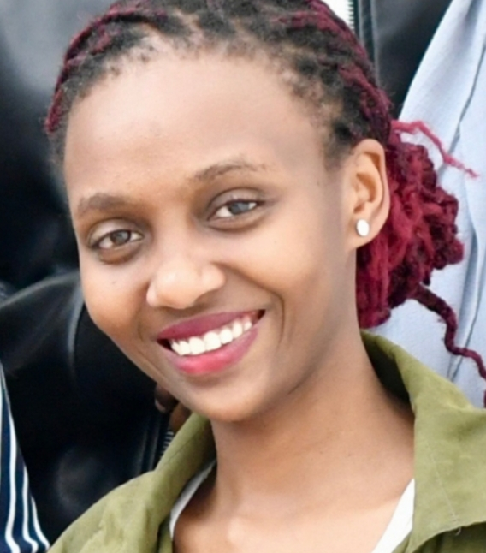
SHANNON MUJERA Shannon is an Informatics and Computer Science student at Strathmore university. She is seasoned leader having served as a student leader, youth ambassador for the UNDESA among other roles. She is a passionate innovator who believes in the power of technology changing lives. She is also skilled in entepreneurship and business development.

Slide 13
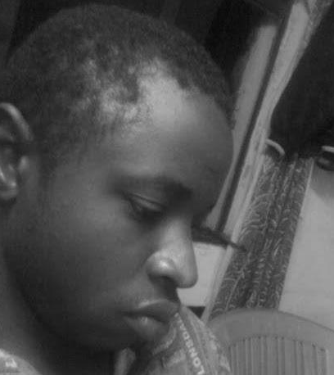
ARTHUR EARL Arthur Earl is a student at Moringa school. He is a full stack developer skilled in flask, Django , javascript among other web technologies. He is passionate about problem solving and loves to take on new challenges.

Slide 14
Corruption is a rampant menace in Africa and beyond. Courts and other law enforcement agencies often rule in favor of accused persons due to tampering of evidence that results in insufficient grounds to take legal action.
Hence the need of I-reporter. I-Reporter is a web-based application platform that aims to ensure integrity and accountability in corruption reporting.
It does this by employing smart contracts to ensure whistle blower evidence is not tampered with.
The smart contracts deployed on the block chain network ensures transparency and integrity.
I –reporter will drastically reduce corruption incidents by up to 50%. Its potential goes beyond the borders to ensure justice is served and integrity in the judicial systems is upheld.
KEY POINTS SUMMARY

Slide 15

USE OF PROCEEDS Proceeds will be used in building the team. A larger and skilled team is needed to ensure large scale development and deployment of the system. In addition proceeds will be required in business development ,marketing and establishing partnerships.

Slide 16

THANK YOU FOR CHOOSING i-Reporter!

